Slide 1
Thinking of changing schools?
You’re not alone — and it doesn’t have to be hard.
Most families who move have a good reason. This is how HLC answers it — and what your child can look forward to at every stage.
HLC International, Karanai, OMR

Slide 2
WHY FAMILIES COME TO US
You may recognise your reason here.
Too much pressure
Not known
The school ends, or lacks the subjects
Rigour without fear. Marks are never announced or compared.
Small groups, and adults who know your child by name.
One school to Grade 12, and a wide choice of subjects.
A new city, or a move abroad
A difficult time
Whatever the reason, the world your child is growing into has changed. The next pages show what that means at your child’s age — and how HLC prepares them for it.
A Cambridge education, recognised worldwide, and a plan to help your child settle.
Inclusion from day one, and a named adult who checks in.

Slide 3
FIND YOUR CHILD’S STAGE
Turn to the page for your child’s age.
Grades 1 to 5
Grades 6 to 9
Grade 11
The rule has changed — and it starts early.
The rule has changed — and so has your child.
The rule has changed.
Joining later in primary? The same three promises apply — and you will see the difference within the first year.
The first public exam shows the road ahead — chosen, not assigned.
Two years to the gate. Send them through carrying more.
Page 4 →
Page 5 →
Page 6 →

Slide 4
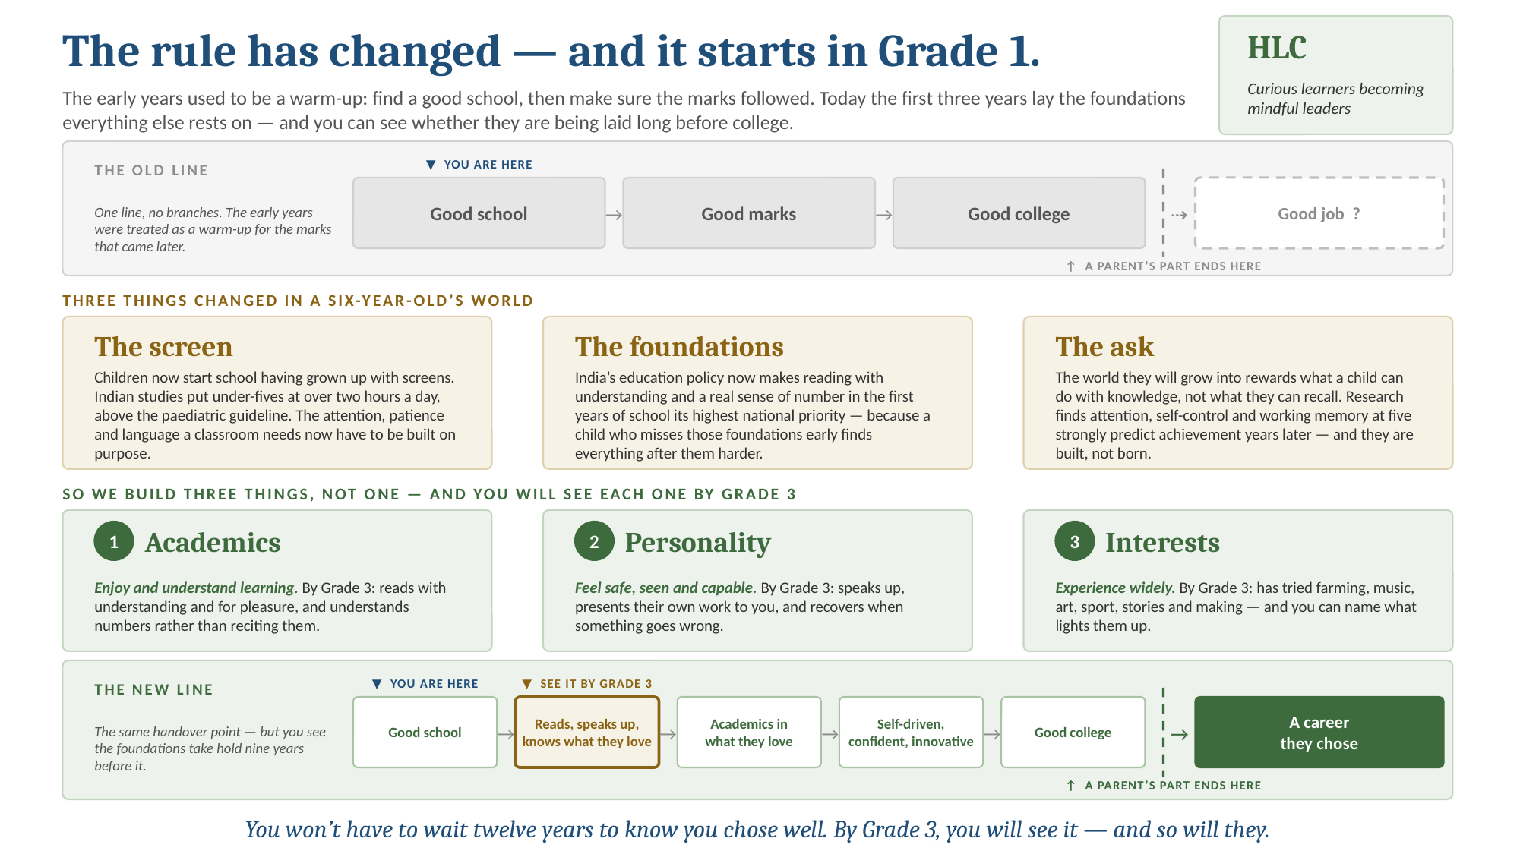

Slide 5
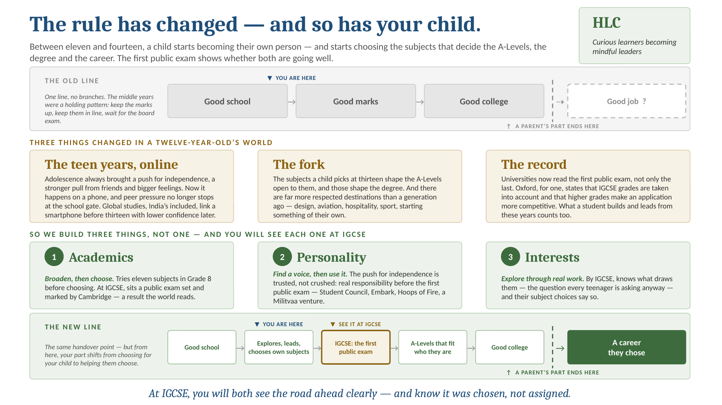

Slide 6
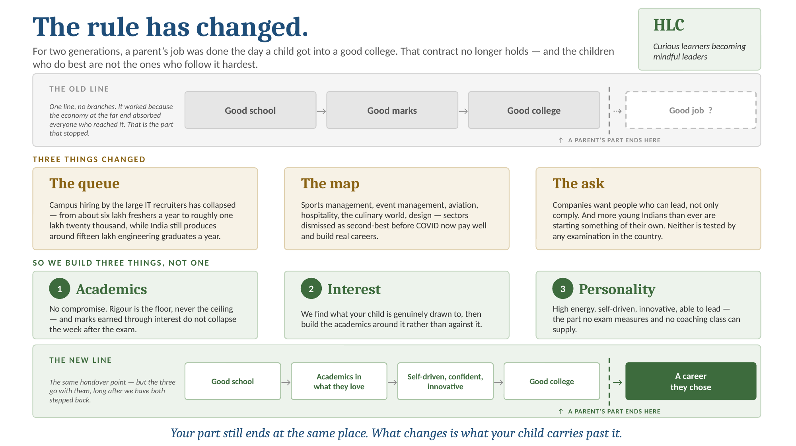

Slide 7
IS SWITCHING A RISK?
Look at where our students go.
29%
60%
17
study abroad, across 11 countries
chose a path beyond engineering or medicine
A-Level subjects to build their own combination
WHERE THEY STUDY
IIT Madras (BS Data Science) · BITS Pilani · Ashoka · NIFT · FLAME · Imperial College London · University of Manchester · NUS · University of Hong Kong · UBC · Georgia Tech · Northwestern · University of Michigan · Sciences Po
WHAT THEY WENT ON TO DO
A NASA fellow
A Marie Skłodowska-Curie fellow
A founder and CEO
PhD in planetary science, searching for habitable worlds
Europe’s most prestigious research fellowship
Building a company for the social sector
From HLC alumni records, 2012–2026.

Slide 8
MAKING THE MOVE
Start with a conversation, not a form.
1 Talk to us
2 A day with us
3 A settling plan
4 Now or in June
Tell us what isn’t working. We listen first.
Your child spends a day in class before you decide.
A buddy, a named adult, and a plan for the first weeks.
Mid-year where a place is free, or planned for June. We’ll help you choose.
YOUR FACT SHEET ANSWERS THE PRACTICAL QUESTIONS
Fees and payment options, including a mid-year move · moving from another board · seats in your child’s grade · Grade 11 subjects and college recognition · paperwork and first-day steps
Visit our open classrooms on Vijayadasami, Tuesday 20 October — or book a weekday visit.
Talk to us: [website] · [phone] · HLC International, Karanai, OMR
The roads have changed. Raise them to find their own way.

